Slide 1
Harold Pulcher
Senior Consultant and Microsoft MVP

Slide 2


Harold Pulcher (MVP) @haroldpulcher harold.pulcher@improving.com
https://youtube.com/user/hpulcher https://twitch.tv/haroldpulcher
http://bit.ly/blazor-20200204

Slide 3
Agenda:
What is Blazor?
Getting Started
New Features in Blazor WebAssembly
What’s Next
Fun Stuff!

Slide 4




https://...
JS
Notes:
Way back to 2016-2017
Used Angular, React, or Vue
Then along come WA

Slide 5
INTERACTIVE WEB UI FOR .NET
A BIGGER APP ON WEBASSEMBLY
Notes:
This is all there is to it. Nothing more and nothing less.

Slide 6
Why you should be interested in this?
C# Language
Tooling / IDE
Consistent ecosystem
Stability
Notes:
C# is used by lots and lots and lots and lots and lots…..
Microsoft usually has about 10 years of support.
It has the tooling you are probably already using if you are in the .NET space.
Plays well up and down the Microsoft stack. But that that doesn’t mean you have to use it?

Slide 7



https://...
DOM
Client-side
(Blazor WebAssembly)

Slide 8
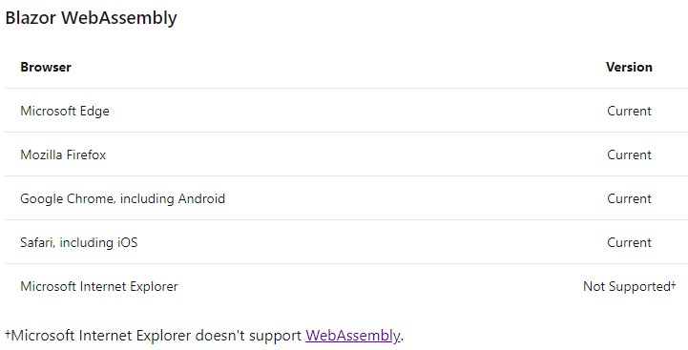

Slide 9


https://...
https://...
SignalR
DOM
DOM
Client-side
(Blazor WebAssembly)
Server-side
(Blazor Server)

Slide 10
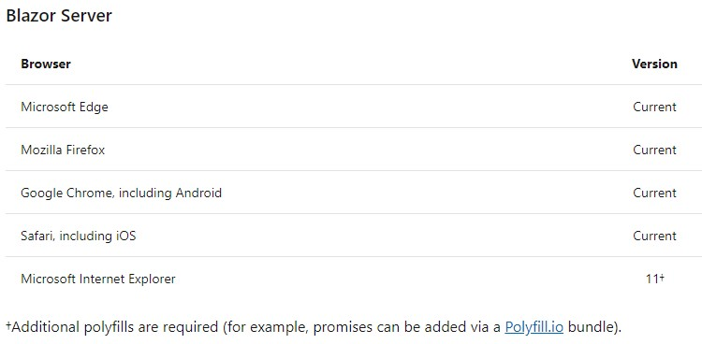

Slide 11
Client-side
(Blazor WebAssembly)
Server-side
(Blazor Server)
Shipped
Released in .NET Core 3.1
Shipped
Released in .NET Core 3.0
Great for:
- Offline support / PWA
- Zero latency UI
- Static-files hosting
Great for:
- Thin client
- Full runtime
- All code on server
Notes:
Where does blazorwasm run?
Where does blazorserver run?

Slide 12
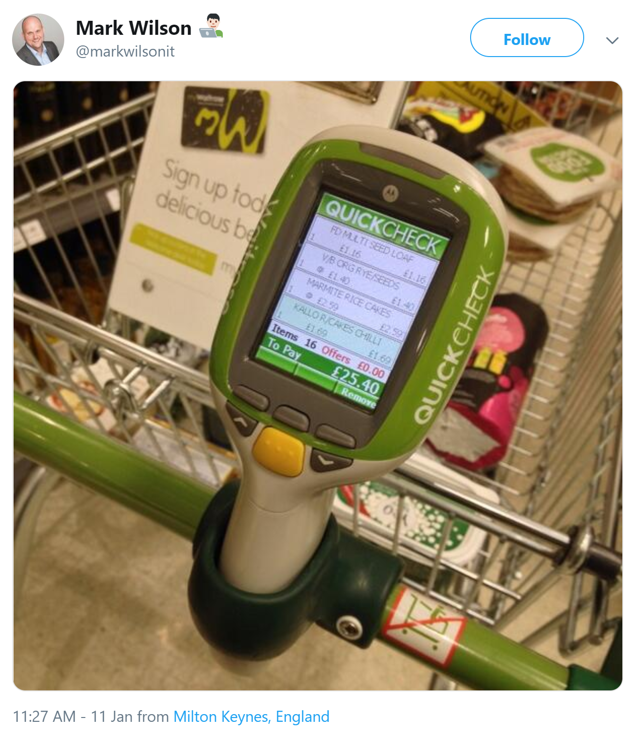
Notes:
Which version would you use on this device?
Wasm:
Fast response
Occasionally connected
Can take a beating
Server:
Mass network coverage
Small memory footprint
Maybe you can’t update the browser?

Slide 13
Get Started
Pick your tool of choice: Visual Studio 2019, Visual Studio Code, or Visual Studio for Mac
Install .NET Core 3.1 SDK, or better yet NET 5.0
https://dotnet.microsoft.com/download
For Webassembly:
For Server:
dotnet new blazorwasm -o blazor-wasm1
cd blazor-wasm1
dotnet run
dotnet new blazorserver -o blazor-server1
cd blazor-server1
dotnet run

Slide 14
Let’s see this in action!

Slide 15


Authorization
Code sharing
Notes:
Fire up CarChecker
Show login/logout
Talk about Azure B2C, twitter, Github, etc…. Any OIDC
Show the annotation in the code → just like any other .NET application….. Did I mention cohesive ecosystem?
Cehicle controller
[Authorize]
Client: Program.cs
.AddHttpMessageHandler<>
Code Sharing
Shared Project
- Vehicle
- Inspection Notes
Declars Schema
Validators
- both server and client
Defines the Wire format
Add required to photograph?
-nuget package
- blazor input file

Slide 16


JavaScript interop
Debugging

Slide 17
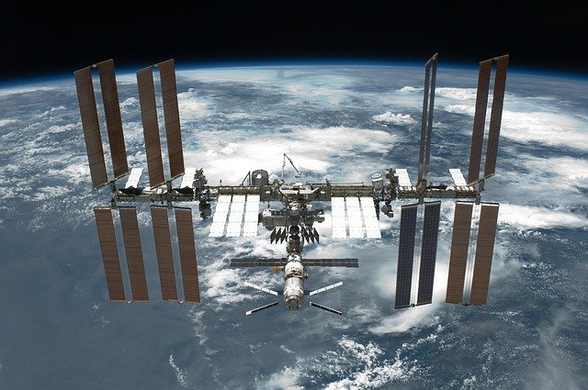
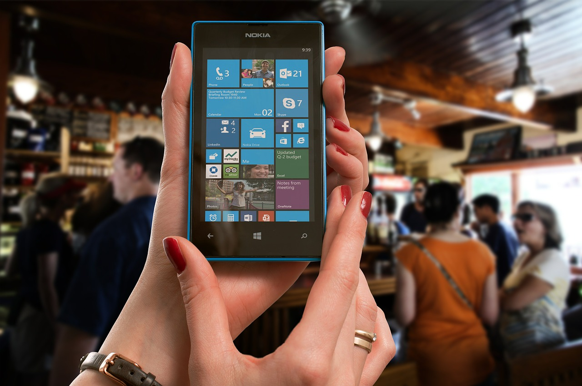
Progressive
Internationalization
Web Apps

Slide 18
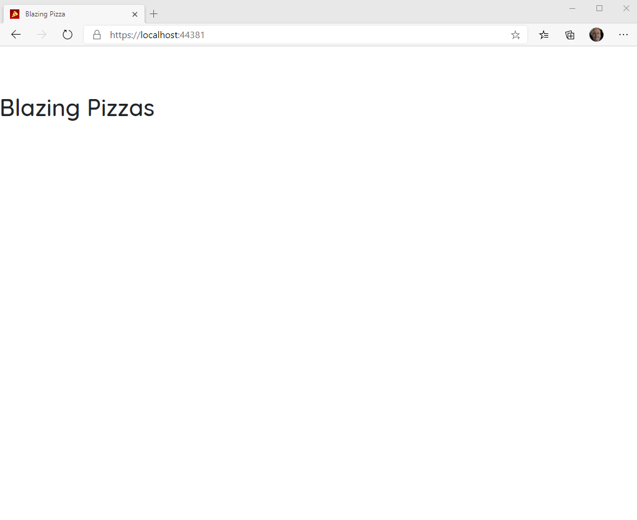
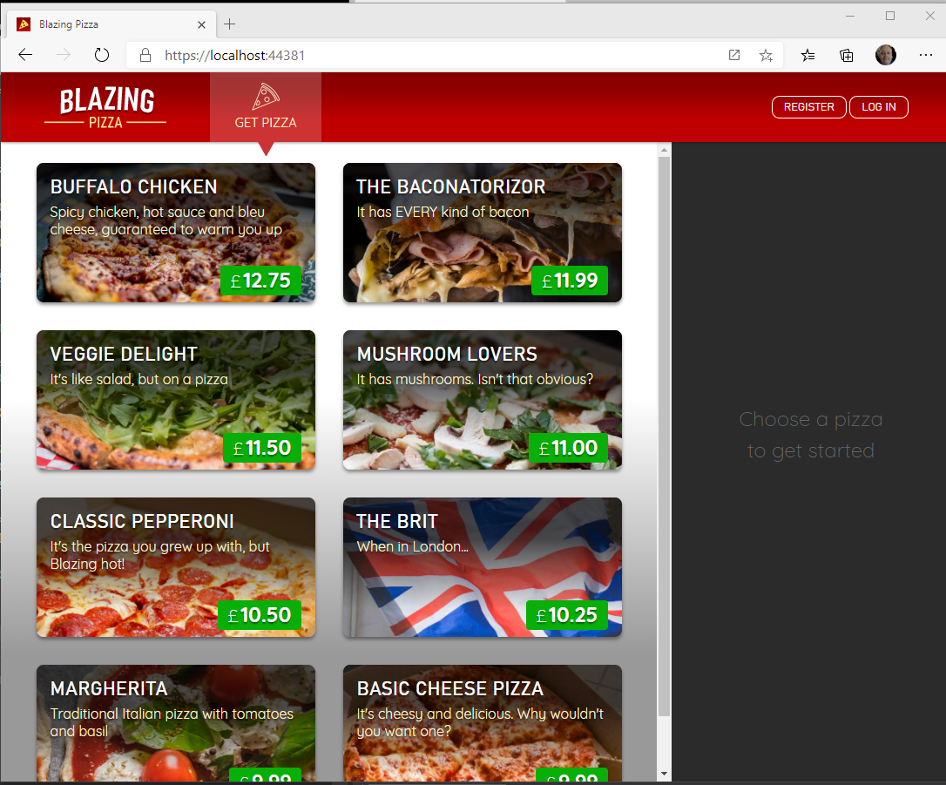

Blazor Workshop
Just Do It!!!!
https://github.com/dotnet-presentations/blazor-workshop

Slide 19
Client-side
(Blazor WebAssembly)
Server-side
(Blazor Server)
Shipped
Released in .NET Core 3.1
Shipped
Released in .NET Core 3.0
Blazor Hybrid
(Desktop app with web rendering)
Blazor + Native UI
(Mobile/desktop with native OS UI)
Uncommitted. Samples:
aka.ms/blazor-electron aka.ms/webwindow
Uncommitted. Samples: aka.ms/mobile-blazor-bindings

Slide 20
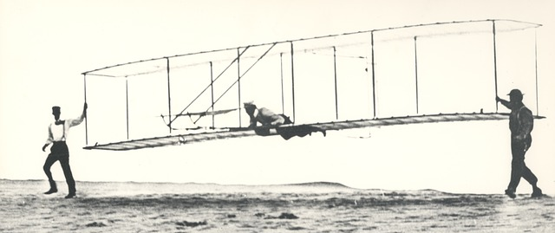
What’s next?
Component API Enhancements:
Type constraints, Required Parameters…..
SVG
CSS Isolation
WebAssembly Specific
Multithreaded Runtime
Lazy-Loading

Slide 21
My Asks:
Head over to http://blazor.net and give it a go
Checkout https://aka.ms/blazor-carchecker
Do the workshop!
Send me some feedback: harold.pulcher@improving.com
Follow me on Twitch and Twitter: @haroldpulcher

Slide 22
Links and stuff
Steve Sanderson Video (used the start of this) presentation: https://www.youtube.com/watch?v=Khn7sDUSEJM
Webassembly base information: https://webassembly.org/
Blazor Getting Started: https://docs.microsoft.com/en-us/aspnet/core/blazor/get-started?view=aspnetcore-3.1&tabs=visual-studio
Blazor Templates: https://www.nuget.org/packages/Microsoft.AspNetCore.Blazor.Templates/
Blazor Routing: https://docs.microsoft.com/en-us/aspnet/core/blazor/routing?view=aspnetcore-3.1
Blazor Workshop: https://github.com/dotnet-presentations/blazor-workshop
WebWindow: https://github.com/SteveSandersonMS/WebWindow
.Net Conf: Focus on Blazor: https://channel9.msdn.com/Events/dotnetConf/Focus-on-Blazor
Basteroids: https://aesalazar.github.io/AsteroidsWasm/
Blazor Pacman: https://pacmanblazor.azurewebsites.net/
* All images are personal or obtained from the “free” section of pixabay.com

Slide 24
WITH
FUTURE
FEATURES
INTERACTIVE WEB UI FOR .NET
A BIGGER APP ON WEBASSEMBLY

Slide 25
WITH
FUTURE
FEATURES
A BIGGER APP ON WEBASSEMBLY
BLAZOR EVERYWHERE
gRPC
Testing
PWA

Slide 26
WITH
FUTURE
FEATURES
A BIGGER APP ON WEBASSEMBLY
BLAZOR EVERYWHERE
gRPC
Testing
PWA

Slide 27

LEARN MORE & GET STARTED
blazor.net
Steven Sanderson
@StevenSanderson

Slide 28
Code sharing

Slide 29
JavaScript interop

Slide 30
Debugging

Slide 31
Internationalization

Slide 32
Progressive Web Apps

Slide 33
LEARN MORE & GET STARTED
blazor.net
CODE & SLIDES
aka.ms/sanderson-london-2020
== https://github.com/SteveSandersonMS/presentation-2020-01-NDCLondon
Steven Sanderson
@StevenSanderson

Slide 34

1
2
3
PIN
* * * *
CART
Item 1
£3.95
Item 2
£12.00
Total: £15.95
0000 0000 0000 0000

